Slide 1
While waiting,
Please log onto the computers.
JMB USER
Clippers2016!
Go to the internet--Google.
Search jdcooper.weebly.com
Choose “Test Prep—Semester 1”

Slide 2
Testing Preparation
Testing requirements as of 2017
Looking at the New SAT
Test Preparation
A few helpful hints

Slide 3
Testing Requirements as of 2017
PARCC
HSA
SAT/ACT

Slide 4
PARCC Algebra I and PARCC English 10
First taken 2016-2017 Achieve a passing score of 725 | First taken in 2017-2018 Achieve a passing score of 733 | First taken in 2018-2019 Achieve a passing score of 741 | As 2017, students who have not achieved a passing score will complete a Bridge project through a summer course or English 11.
PARCC 10 Practice

Slide 5
HSA
HSA Science
2017 Graduates Pass Required
HSA Government
2017-2019
2018 Graduates participation only
Graduates achieve a passing score of 394

Slide 6
ACT preparation
The ACT is often chosen over the SAT.
Most colleges accept it.
The ACT tests five areas: English, Math, Reading, Science and Writing.
A score (ranging from 1 to 36) is determined, giving a maximum possible total score of 36. The median total score on the ACT is 21.1.
Try a practice test http://www.act.org/content/dam/act/unsecured/documents/Preparing-for-the-ACT.pdf

Slide 7
Re-designed SAT
What it is, what it looks like, and what you can do about it.

Slide 8
SAT
All juniors will take the SAT in March.
This test is paid for by the BOE.
Results will be available approximately 2-3 weeks after taking the test.
Feedback is provided to help students increase their scores.
This is not a graduation requirement.
A score of 500 in Language and 500 in Math earns College and Career Ready status.

Slide 9
ReADING

Slide 10
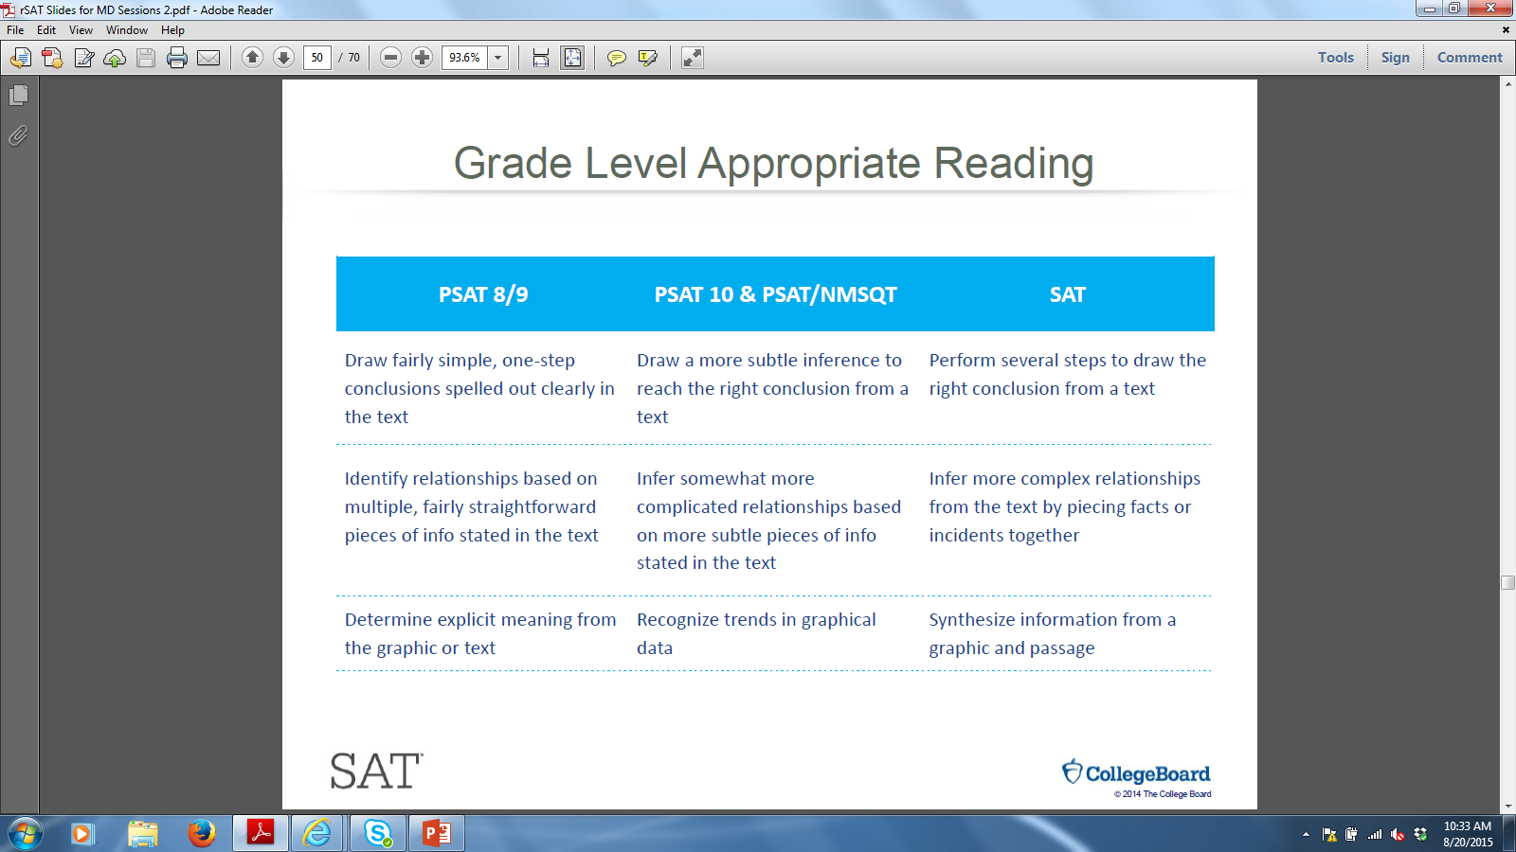

Slide 11
So, what will you have to Do?
You will have to analyze scientific and historical documents (21 questions for each content; 42 questions total).
There will be informational graphics on the test (1-2 in history/social studies; 1 for science) that you will also have to analyze.
There will be a piece of American or World Literature (10 questions).
Questions will require text evidence.
Words will need to be defined in context.

Slide 12
SO, How will you do it?
A+ = ANNOTATE!
Put the text in your own words.
Identify the main idea for each paragraph.
Consider the reading basics: who, what, where, when, and why.
Underline what you can.

Slide 13
AND WHAT ELSE?
READ
Whether online or traditional print, read and discuss informational text (non fiction) at home.
Consider subscriptions to Smithsonian, which presents informative articles about science and social studies.

Slide 14
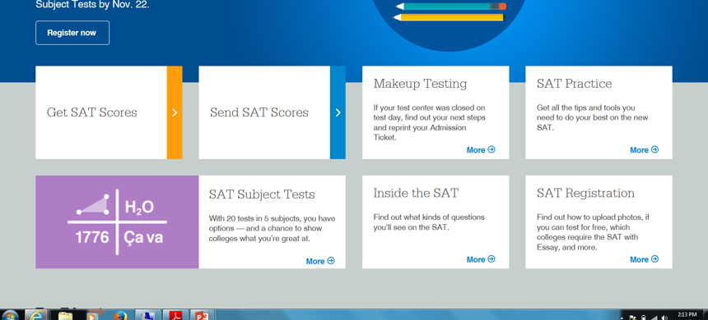

Slide 15
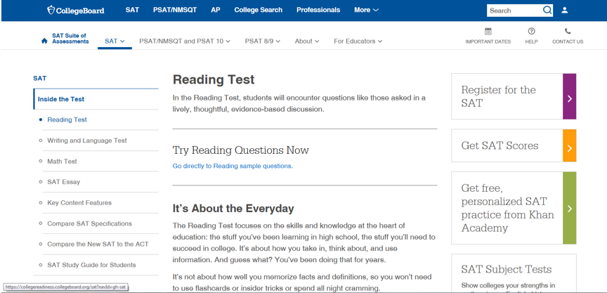

Slide 16
Scroll to the bottom of the page

Slide 17
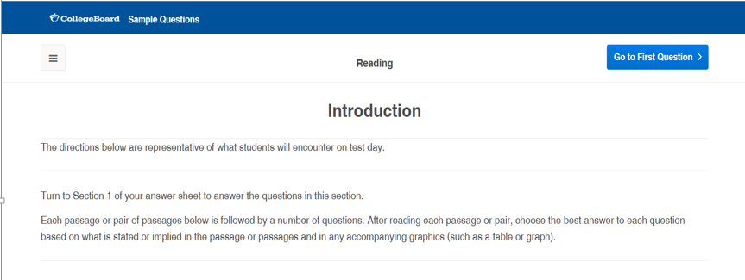

Slide 18
SAMPLE 1
https://collegereadiness.collegeboard.org/sample-questions/reading/6
Try question #6 from the SAT sample.
Remember to annotate!
Identify the purpose of the question.

Slide 19
Sample 2
https://collegereadiness.collegeboard.org/sample-questions/reading/8
Now try question #8 from the SAT sample. It assesses a different kind of reading skill.
What helped you to answer this question?

Slide 20
WRITING

Slide 22
So, what can you expect?
Questions will be linked to approximately 4 longer sample passages.
For about 20 questions, you will be asked about basic English conventions, like punctuation, usage and sentence structure.
You will also need to add evidence to the writing; some of this evidence will come from a chart or a table (These may be part of the Expression Questions).
You will also need to examine organization and expression of ideas (24 questions).
The essay, much like the literary diagnostics and summatives that you take, will require you to analyze a piece of writing. It is optional.

Slide 24
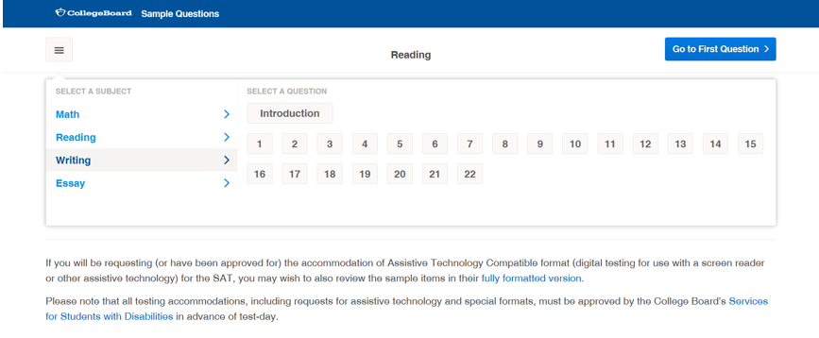

Slide 25
Sample 1
https://collegereadiness.collegeboard.org/sample-questions/writing/1
Try question #1 from the SAT sample test.
Read the passage first.
Annotate with three bullet points at the end of the text.
Go to the question.
What grammatical concept is assessed through this question?

Slide 26
Sample 2
https://collegereadiness.collegeboard.org/sample-questions/writing/11
Try question #11 from the SAT sample test.
Read the graph.
Annotate it with a sentence summary.
Connect the annotations for both selections.
Answer the question.
Is this question challenging?

Slide 27
So how do I prepare for this?
Move beyond “one and done” writing.
Look over and revise your writing consistently.
Practice sample questions online.
Look for errors in published documents.

Slide 28
What about the essay?
Understand the prompt.
Know what the appeals of argument are.
Name them.
Identify them.
Explain them.
Know how to discuss an author’s craft.
Look at word choice.
Consider sentence structure.
Plan your response.
A= address the prompt with a thesis statement
C= cite evidence to support your topic
E= explain how the evidence connects to the thesis or purpose
S= summarize at the end of each body paragraph and the essay

Slide 29
MATHEMATICS

Slide 30
Grade level appropriate math
Area of Focus | PSAT 8/9 | PSAT 10 AND PSAT/NMSQT | SAT
Complexity | Many items requiring one or two steps to solve. | Many items requiring two or more steps to solve. | Emphasis on multistep problems.
Geometry | May require the use of common geometric equations. | May require the use of common geometric equations and spatial reasoning. | Requires the use of geometry concepts and reasoning.
Probability and Statistics | Includes ratios, proportions, percents, introductory probability, and statistics. | Requires comparing linear and exponential growth. | Includes statistics topics such as sampling and inferring correlation and causation from a research method.
Trigonometry | May require the use of properties of right triangles to solve problems. | Requires the use of trigonometric relationships. | Requires the use of trigonometry.

Slide 31
OVERALL VIEW
Stronger command of fewer important topics
Command and fluency of mathematical procedures
Conceptual understanding of math ideas
*** Calculator portion (55 minutes)
***Non-calculator portion (25 minutes)

Slide 32
HEART OF ALGEBRA
There will be 19 questions on this section.
Questions will cover
Linear equations in one variable
Linear functions
Linear equations with 2 variables
Systems of 2 linear equations in 2 variables
Linear inequalities in 1 or 2 variables

Slide 33
Problem solving and data analysis
There will be 17 questions on this section.
Information assessed here will cover
Ratios, rates proportional relationships and units
Percentages
1 variable data
2 variable data
Probability and conditional probability
Information from sample statistics and the margin of error
Evaluating statistical claims

Slide 34
Passport to advanced mathematics
Nonlinear functions
Equivalent expressions
Nonlinear equations in 1 variable systems of equations in 2 variables

Slide 35
So, What should I do?
Use your mental math more frequently.
When shopping, estimate the tax.
Figure out percentage off discounts.
Determine what to tip a server.
Review using the practice problems.
Use the College Board website to guide you through some questions.
Determine what areas you need to review.

Slide 37
SAMPLE
Look at sample problems in this section.

Slide 38
SCORING

Slide 39
WHAT DO YOU NEED TO KNOW?
This version of the SAT is worth 1600 points.
Information about your results will come to you in a variety of subscores to help you improve the next time you take the test. Most people take the test three times.

Slide 42
Another good source:
Prep Scholar—helpful hints for the SAT and ACT
Ivy Global—Practice Tests
JMB Databases—Choose extensive reading in science, technology, and history
Look for articles with graphs and charts (2-3 questions for every section)
Wide reading in science, history, geography, social studies, biographies and economics as well as literature.

