Slide 1
Gawain and the Green Knight
A Review
Notes:
NOTE:
To change the image on this slide, select the picture and delete it. Then click the Pictures icon in the placeholder to insert your own image.

Slide 2
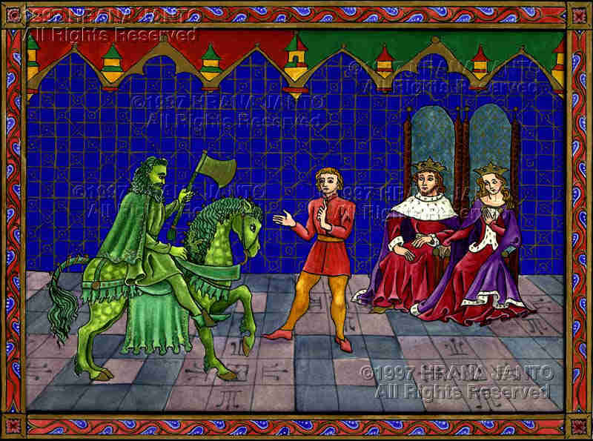
During Christmastide, King Arthur hosts a banquet at Camelot.
He demands a diverting tale before the meal.
A giant green knight bursts through the door on his horse.
The Green Knight shocks the court, challenges Arthur, and mocks his knights.

Slide 3
Gawain accepts the challenge.
Gawain can strike the Green Knight once with the green ax if he agrees to face the same fate in one year at the Green Chapel.

Slide 4
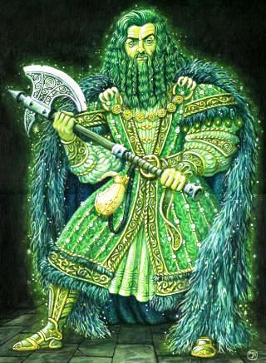
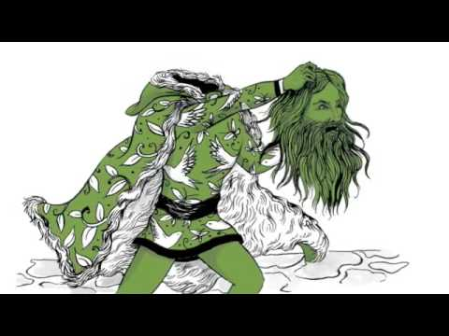
Magical/Supernatural Elements
The man, his horse, and ax are green.
The Knight talks to Gawain after he is beheaded.

Slide 5
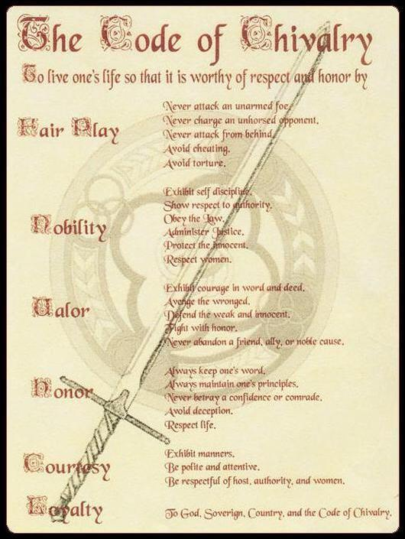
Gawain’s Word is his Troth.
He must find the Green Chapel by the end of the year.
He must face the strike of the ax bravely.
He must stay true to the Code of Chivalry.

Slide 6
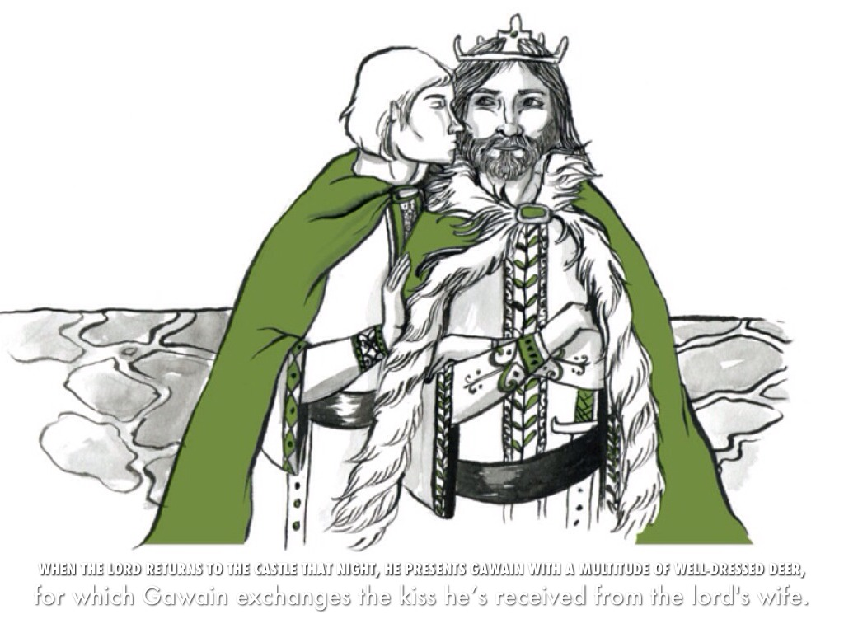
Gawain is tempted by the Red Lord’s wife.
1st Morning—she tempts him with earthly pleasure. He receives one kiss.
2nd Morning—she tempts him with riches and power. He receives two kisses.
3rd Morning—she tempts him with keeping his life. He accepts a kiss and the green sash.
Gawain remains true to the code of chivalry until the lady offers the green sash and a chance to save his life. He keeps the sash and lies to the Red Lord.

