Slide 1
The Romantic Age
Another model for IR presentation WaHaa!
Concluding with Shelley, Austen and Shelley

Slide 2
Homework—Tues. April 27
Read the Pride and Prejudice selection on p. in your textbook.
What does the selection tell you about society (culture of the genteel society of men and women) during the late Romantic Period?
What does the selection and Austen’s biography lead you to believe concerning her opinions of marriage?

Slide 3
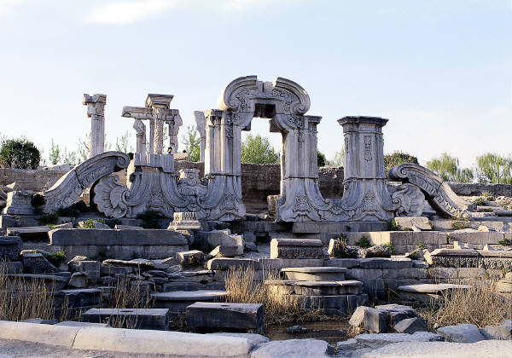
Percy Bysshe Shelley
p. 544 “Ozymandias” Read & Response:
What is the condition of the monument described in the poem?
What is the attitude of the ruler immortalized in the monument?
Why is the condition of the monument ironic?

Slide 4
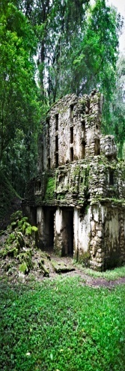
Ozymandias
I met a traveler from an antique land Who said: Two vast and trunkless legs of stone Stand in the desert . . . Near them, on the sand, Half sunk, a shattered visage lies, whose frown, And wrinkled lip, and sneer of cold command Tell that its sculptor well those passions read Which yet survive, stamped on these lifeless things, The hand that mocked them, and the heart that fed.

Slide 5
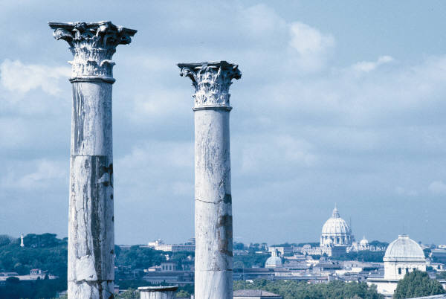
And on the pedestal these words appear: "My name is Ozymandias, king of kings: Look on my works, ye Mighty, and despair!" Nothing beside remains. Round the decay Of that colossal wreck, boundless and bare The lone and level sands stretch far away.
(1818)

Slide 6
Friendly Competition
Horace Smith was a friend of Percy Bysshe Shelley, and helped to manage his finances. Inspired by Diodorus Siculus (Book 1, Chapter 47), they each wrote and submitted a sonnet on the subject to The Examiner.
Shelley's was published on January 11, 1818 under the pen name Glirastes.
Smith's was published on February 1, 1818 with the initials H.S. Smith's poem was later published under the title On A Stupendous Leg of Granite, Discovered Standing by Itself in the Deserts of Egypt, with the Inscription Inserted Below. in his collection Amarynthus.
The poem can be found in:
Original Poetry. (1818, February 1). The Examiner (London), p. 73. Smith, Horace. Amarynthus, The Nympholet: A Pastoral Drama, In Three Acts. With Other Poems. London: Printed for Longman, Hurst, Rees, Orme, & Brown, 1821.

Slide 7
Horace Smith (1779-1849) Ozymandias.
IN Egypt's sandy silence, all alone, Stands a gigantic Leg, which far off throws The only shadow that the Desart knows:— "I am great OZYMANDIAS," saith the stone, "The King of Kings; this mighty City shows "The wonders of my hand."— The City's gone,— Nought but the Leg remaining to disclose The site of this forgotten Babylon.
We wonder,—and some Hunter may express Wonder like ours, when thro' the wilderness Where London stood, holding the Wolf in chace, He meets some fragment huge, and stops to guess What powerful but unrecorded race Once dwelt in that annihilated place.

Slide 8
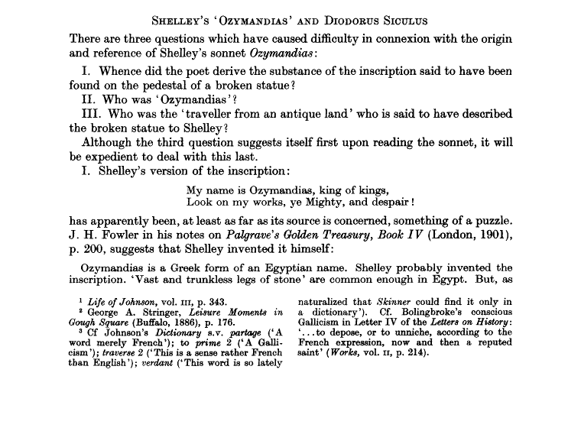
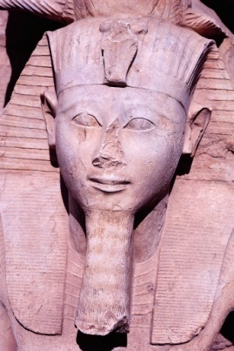

Slide 9
Travel Literature
Travel literature offers experience to the entirety of a literate public and for that reason alone has historically had far greater cultural impact than the experience of mere travel itself, which can only be individual and private.
To take one small and suggestive example: the two most popular manuscript texts of the late Middle Ages were probably Mandeville's Travels and Marco Polo's Description of the World. Like Herodotus' Histories, these two books are literary compilations, rather than simple records or observations, and as such they quite rightly include fictional elements. It was inevitable that they should have been among the earliest European best-sellers in print, anticipating by many decades the great Renaissance collections of Ramusio and Hakluyt.

Slide 10
Travel Literature?
But what were the needs they obviously fulfilled? The question cannot begin to be answered until we bear in mind that they inspired not only More's Utopia--the fountainhead of an artistic lineage that includes major works of Rabelais, Cervantes, Bacon, Swift, Defoe, Voltaire, Melville, Twain, Shaw, Wells, Huxley, Orwell, Nabokov, and Calvino, not to mention V. S. Naipaul, Paul Theroux and J. G. Ballard--but also Columbus' voyage in search of the Indies. In the case of Shelley's "Ozymandias" the fact that the poem has nothing to do with the poet/speaker's personal physical experience is announced by the first line, which tells us explicitly that the person who had the fictive experience that the poem uses as its central metaphor was not the poet-speaker at all, but "a traveler":

Slide 11
Works Cited
Shelley's "Ozymandias" and Diodorus Siculus J. Gwyn Griffiths. The Modern Language Review, Vol. 43, No. 1 Jan. 1948, pp. 80-84. (Print).
“Travelers from an antique land: Shelley’s inspiration for “Ozymandias.” 1 Jan 04. Alif: Journal of Comparative Poetics. (Print)

