Slide 1
Research 1 Template
Divide your topic into 3-4 subtopics
Use 1-2 slides per topic
Use the notes section for sentences explaining the slide as if you are presenting it.

Slide 2
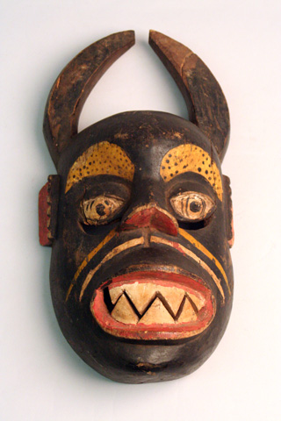
Subject
Phrases
Only
Please
No sentences
Notes:
Write your notes in sentences. Use this section for your facts.

Slide 3
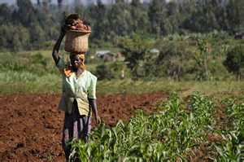
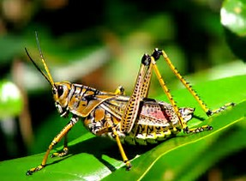
Nigerian culture--Food
Kola Nuts
Palm Oil
Yam/ Sweet potato
Grasshoppers
Notes:
The Ibo are primarily farmers. They grow yams and tend the kola plants and palm trees.

Slide 4
Topic—Using quotes
Notes:
Comment on the importance of the quote in the notes section. Use complete sentences.

